Slide 1
COMPUTER ORGANIZATION AND ARCHITECTURE
Dr. Rizwan Khan
Head – Department of Computer Science and Engineering
(An NBA Accredited Program)
ABES Institute of Technology, Ghaziabad

Slide 2
MEMORY ORGANIZATION
Memory Hierarchy
Main Memory
Cache Memory
Virtual Memory

Slide 3
MEMORY HIERARCHY
Memory Hierarchy
Memory Hierarchy is to obtain the highest possible
access speed while minimizing the total cost of the memory system
Auxiliary memory
Magnetic
tapes
I/O
Main
processor
memory
Magnetic
disks
CPU
Cache
memory
Register
Cache
Main Memory
Magnetic Disk
Magnetic Tape

Slide 4
Characteristics
Location
Capacity
Unit of transfer
Access method
Performance
Physical type
Physical characteristics
Organisation

Slide 5
Location
CPU
Internal
External

Slide 6
Capacity
Word size
The natural unit of organisation
Number of words
or Bytes

Slide 7
Unit of Transfer
Internal
Usually governed by data bus width
External
Usually a block which is much larger than a word
Addressable unit
Smallest location which can be uniquely addressed
Word internally
Cluster on M$ disks

Slide 8
Access Methods (1)
Sequential
Start at the beginning and read through in order
Access time depends on location of data and previous location
e.g. tape
Direct
Individual blocks have unique address
Access is by jumping to vicinity plus sequential search
Access time depends on location and previous location
e.g. disk

Slide 9
Access Methods (2)
Random
Individual addresses identify locations exactly
Access time is independent of location or previous access
e.g. RAM
Associative
Data is located by a comparison with contents of a portion of the store
Access time is independent of location or previous access
e.g. cache

Slide 10
Memory Hierarchy
Registers
In CPU
Internal or Main memory
May include one or more levels of cache
“RAM”
External memory
Backing store

Slide 11
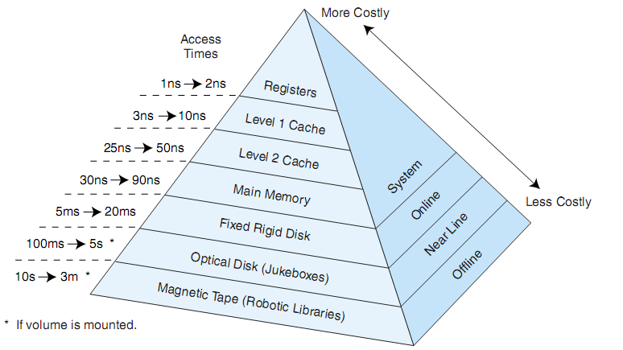
Memory Hierarchy

Slide 12
Performance
Access time
Time between presenting the address and getting the valid data
Memory Cycle time
Time may be required for the memory to “recover” before next access
Cycle time is access + recovery
Transfer Rate
Rate at which data can be moved

Slide 13
Physical Types
Semiconductor
RAM
Magnetic
Disk & Tape
Optical
CD & DVD
Others
Bubble
Hologram

Slide 14
Physical Characteristics
Decay
Volatility
Erasable
Power consumption

Slide 15
Organisation
Physical arrangement of bits into words
Not always obvious
e.g. interleaved

Slide 16
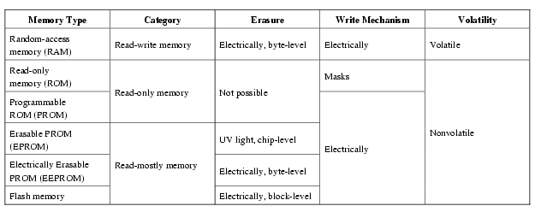
Semiconductor Memory Types

Slide 17
Semiconductor Memory
RAM
Misnamed as all semiconductor memory is random access
Read/Write
Volatile
Temporary storage
Static or dynamic

Slide 18
Read Only Memory (ROM)
Permanent storage
Nonvolatile
Microprogramming (see later)
Library subroutines
Systems programs (BIOS)
Function tables

Slide 19


